Slide 1

Data Science Research Methods
Data Wrangling and Cleaning
Dr James Van Yperen

Slide 2
Last Week
Installed Anaconda on your own computer.
Completed the crash course.
Explored Canvas.
Explored:
  What is data science?
  What skills do data scientists need?
  What do data scientists (analysts) do?
Learned about the Data Science process.

Slide 3

I WANT YOUR DATA
I have got approval to collect your data!
If possible, I would like all your responses by the 20th October - that should give me plenty of time to analyse the data.
If you have any questions about the survey and what I plan on doing with your data, then please email me to book an appointment.
Note, participation in this survey has nothing to do with your grade, it is completely up to you if you want to participate.

Slide 4

Labs, Helpdesk, Office Hours, Discord, MSC Drop-in Clinic
Labs: Wednesday 3pm – 4pm, 4pm – 5pm.
  Chichester 016, 017, 018.
Helpdesk: Friday 10am – 11am.
  Online.
Office Hours: Friday 11am - 12pm.
  Pevensey 3 5C15.
  Zoom.
Discord:
  https://discord.com/invite/WQUbJrkfK
Data Science Maths, Stats & Coding Clinic:
  https://canvas.sussex.ac.uk/courses/30255/pages/msc-drop-in-clinic

Slide 5
Today
Week | Topic
0 | Help with Python
1 | Data, the data science process, and data science tools
2 | Data wrangling and cleaning
3 | Exploratory data analysis – summary statistics and visualisation
4-5 | Statistical inference and hypothesis testing
7 | Supervised learning, model selection and making predictions
8 | Unsupervised learning, clustering and visualisation
9 | Dimensionality reduction and principal component analysis
Real world
Data Solution / Product
Data Collection
Communication and Visualisation
Data Wrangling
Exploratory Data Analysis
Mathematical Modelling
Data Cleaning

Slide 6
Pandas: Python Data Analysis Library
A fast and efficient DataFrame object for data manipulation;
Tools for reading and writing data between different formats (e.g., csv, json, xlsx, db);
Intelligent label-based slicing, fancy indexing, and subsetting of large data;
https://pandas.pydata.org/

Slide 7
Pandas: Python Data Analysis Library
A fast and efficient DataFrame object for data manipulation;
Tools for reading and writing data between different formats (e.g., csv, json, xlsx, db);
Intelligent label-based slicing, fancy indexing, and subsetting of large data;
Aggregating of transforming data with a powerful group by engine allowing split-apply-combine operations on data sets;
https://pandas.pydata.org/

Slide 8
Pandas: Python Data Analysis Library
A fast and efficient DataFrame object for data manipulation;
Tools for reading and writing data between different formats (e.g., csv, json, xlsx, db);
Intelligent label-based slicing, fancy indexing, and subsetting of large data;
Aggregating of transforming data with a powerful group by engine allowing split-apply-combine operations on data sets;
Time series-functionality: data range generation and frequency conversion, moving window statistics, date shifting and lagging;
https://pandas.pydata.org/

Slide 9
Pandas: Python Data Analysis Library
A fast and efficient DataFrame object for data manipulation;
Tools for reading and writing data between different formats (e.g., csv, json, xlsx, db);
Intelligent label-based slicing, fancy indexing, and subsetting of large data;
Aggregating of transforming data with a powerful group by engine allowing split-apply-combine operations on data sets;
Time series-functionality: data range generation and frequency conversion, moving window statistics, date shifting and lagging;
Highly optimised for performance;
Already installed if you have Anaconda!
https://pandas.pydata.org/

Slide 10
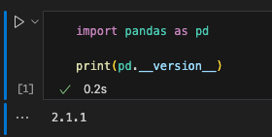
Pandas: Python Data Analysis Library
Check to make sure it is installed by:
  Importing the library;
  Printing the special variable __version__ (two underscores _) to confirm.
TOP TIP

Slide 11
Pandas: Python Data Analysis Library
Check to make sure it is installed by:
  Importing the library;
  Printing the special variable __version__ (two underscores _) to confirm.
TOP TIP

Slide 12
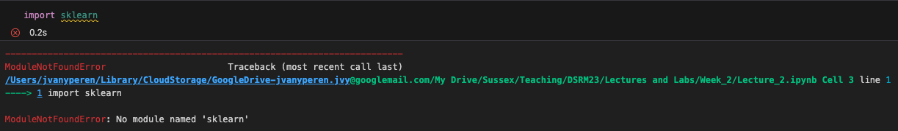
Pandas: Python Data Analysis Library
Check to make sure it is installed by:
  Importing the library;
  Printing the special variable __version__ (two underscores _) to confirm.
If it is not installed, you will receive a ModuleNotFoundError

Slide 13
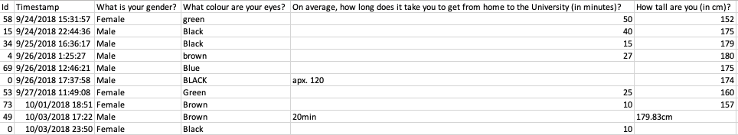
dirty_data.csv
Download Lecture_1.zip, move it from your downloads folder to your DSRM folder, and into a Week 2 subfolder.
Extract it (right click and click extract all).
Open dirty_data.csv in Excel.

Slide 14
dirty_data.csv
Download Lecture_1.zip, move it from your downloads folder to your DSRM folder, and into a Week 2 subfolder.
Extract it (right click and click extract all).
Open dirty_data.csv in Excel.
This is structured data - why?

Slide 15
dirty_data.csv
Download Lecture_1.zip, move it from your downloads folder to your DSRM folder, and into a Week 2 subfolder.
Extract it (right click and click extract all).
Open dirty_data.csv in Excel.
This is structured data - why?
  Categorical data: things with no order.

Slide 16
dirty_data.csv
Download Lecture_2.zip, move it from your downloads folder to your DSRM folder, and into a Week 2 subfolder.
Extract it (right click and click extract all).
Open dirty_data.csv in Excel.
This is structured data - why?
  Categorical data: things with no order.
  Continuous data: numerical data.

Slide 17
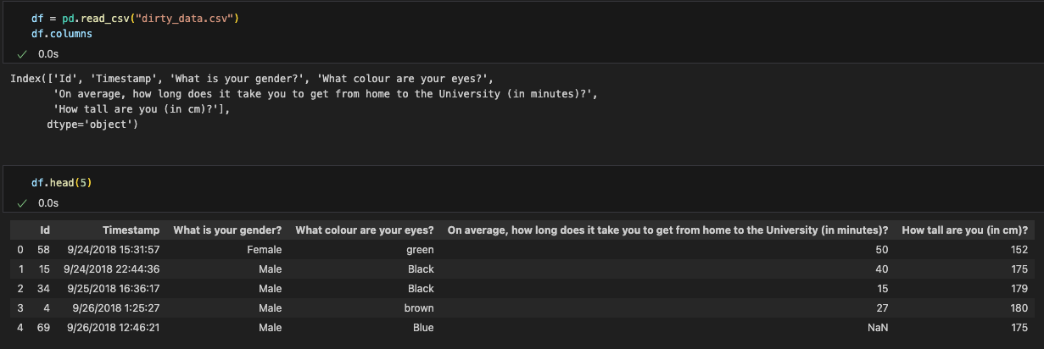
Reading data into pandas
We need to read the data into our notebook so we can wrangle and clean it.
We use the pandas function .read_csv()

Slide 18
Reading data into pandas
We need to read the data into our notebook so we can wrangle and clean it.
We use the pandas function .read_csv()
Print the column names and the first 5 entries (using the python function .head()) to cross reference against what you can see in the Excel spreadsheet.

Slide 19
Reading data into pandas
We need to read the data into our notebook so we can wrangle and clean it.
We use the pandas function .read_csv()
Print the column names and the first 5 entries (using the python function .head()) to cross reference against what you can see in the Excel spreadsheet.

Slide 20
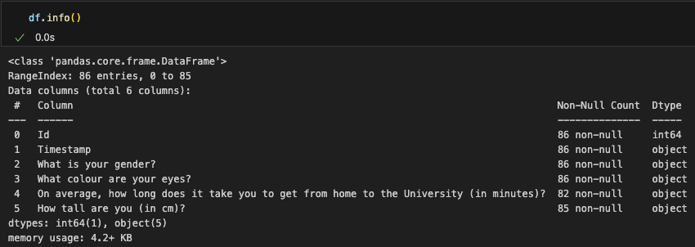
Reading data into pandas: info
First things first, let’s get some basic information about the dataframe.

Slide 21
Reading data into pandas: info
First things first, let’s get some basic information about the dataframe.
We have 86 rows.

Slide 22
Reading data into pandas: info
First things first, let’s get some basic information about the dataframe.
We have 86 rows.
Non-Null Count tells us how many rows are in a specific column are not NaN.

Slide 23
Reading data into pandas: info
First things first, let’s get some basic information about the dataframe.
We have 86 rows.
Non-Null Count tells us how many rows are in a specific column are not NaN.
Dtype is the type of the column entries – pandas tries to automatically detect this.
TOP TIP
Object is the pandas dtype for strings.

Slide 24
Reading data into pandas: info
First things first, let’s get some basic information about the dataframe.
We have 86 rows.
Non-Null Count tells us how many rows are in a specific column are not NaN.
Dtype is the type of the column entries – pandas tries to automatically detect this.
Object is the pandas dtype for strings.
We can see that there some columns that have NaN entries, we will need to communicate this back to the data collector.

Slide 25
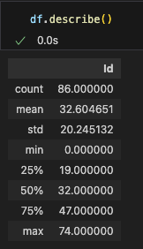
Reading data into pandas: describe
Describe gets statistical information about the columns, so we need to make sure the dtype of each series (the pandas name for a column) is correct.

Slide 26
Reading data into pandas: describe
Describe gets statistical information about the columns, so we need to make sure the dtype of each series (the pandas name for a column) is correct.
Where is height or commute time?
Let us come back to this when we have cleaned the data!

Slide 27
Wrangling with pandas
Wrangling
  seeks to remove that risk by ensuring data is in a reliable state before it's analysed and leveraged.

Slide 28
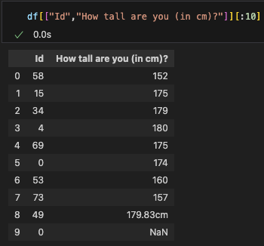

Wrangling with pandas
Wrangling
  seeks to remove that risk by ensuring data is in a reliable state before it's analysed and leveraged.
This data was downloaded straight from an online form, so we need to do a little bit of wrangling!
What might need wrangling?

Slide 29
Wrangling with pandas
Wrangling
  seeks to remove that risk by ensuring data is in a reliable state before it's analysed and leveraged.
This data was downloaded straight from an online form, so we need to do a little bit of wrangling!

Slide 30
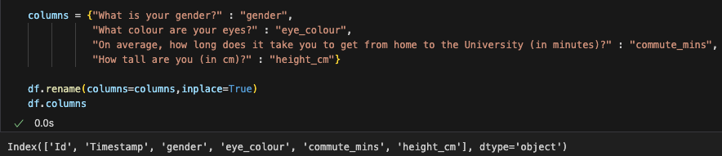
Wrangling with pandas: column names
We need to tell pandas how to rename them.
We use the dictionary data structure for this {key : value}
{current column name : new column name}
Note: we don’t need to put all the column names into the dictionary.

Slide 31
Wrangling with pandas: column names
We need to tell pandas how to rename them.
We use the dictionary data structure for this {key : value}
{current column name : new column name}
Note, we don’t need to put all the column names into the dictionary.
Note, python convention recommends we use snake_case

Slide 32
Wrangling with pandas: column names
We need to tell pandas how to rename them.
We use the dictionary data structure for this {key : value}
{current column name : new column name}
Note, we don’t need to put all the column names into the dictionary.
Note, python convention recommends we use snake_case
We can use inplace to update the dataframe in most methods.
TOP TIP

Slide 33
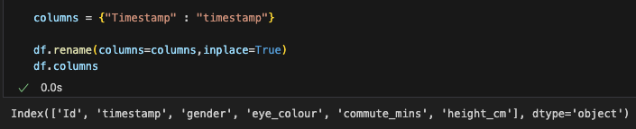
Wrangling with pandas: column names
We need to tell pandas how to rename them.
We use the dictionary data structure for this {key : value}
{current column name : new column name}
Note, python convention recommends that we start variables with a lower case.

Slide 34
Cleaning with pandas
Cleaning:
  process of detecting and amending / removing data that is incorrect, incomplete, improperly formatted or duplicated.

Slide 35
Cleaning with pandas: NaNs
Cleaning:
  process of detecting and amending / removing data that is incorrect, incomplete, improperly formatted or duplicated.
If there are NaNs in the entries, we need to speak to the data collector to understand why they might be there.

Slide 36
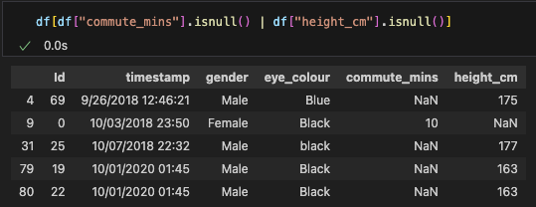
Cleaning with pandas: NaNs
TOP TIP
Cleaning:
  process of detecting and amending / removing data that is incorrect, incomplete, improperly formatted or duplicated.
If there are NaNs in the entries, we need to speak to the data collector to understand why they might be there.
We can search over the whole dataframe using a Boolean statement.
We use the pipe operator | since this needs to be an element wise or operation:
  For each row, display the row if the entry in commute_mins is null or the entry in height_cm is null.

Slide 37
Cleaning with pandas: NaNs
If there are NaNs in the entries, we need to speak to the data collector to understand why they might be there.
In this instance, we are told to drop them from the dataframe.

Slide 38
Cleaning with pandas: NaNs
If there are NaNs in the entries, we need to speak to the data collector to understand why they might be there.
In this instance, we are told to drop them from the dataframe.
Now, we are going to be editing the dataframe entries, so we need to note how many entries we are editing.
We need to tell the data collector that we are dropping 5 out of 86 rows.

Slide 39
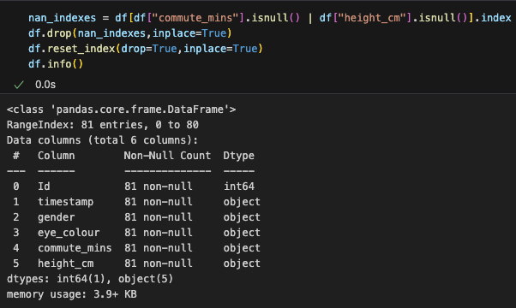
Cleaning with pandas: NaNs
If there are NaNs in the entries, we need to speak to the data collector to understand why they might be there.
In this instance, we are told to drop them from the dataframe.
We need to find all the indexes where a NaN exists
TOP TIP

Slide 40
Cleaning with pandas: NaNs
If there are NaNs in the entries, we need to speak to the data collector to understand why they might be there.
In this instance, we are told to drop them from the dataframe.
We need to find all the indexes where a NaN exists, then drop them.

Slide 41
Cleaning with pandas: NaNs
If there are NaNs in the entries, we need to speak to the data collector to understand why they might be there.
In this instance, we are told to drop them from the dataframe.
We need to find all the indexes where a NaN exists, then drop them.
We have to reset_index otherwise it will think there are still 86 rows, drop stops reset_index from creating a column with the previous indexes.

Slide 42
Cleaning with pandas: duplicates
We should also check for duplicates.
We have a unique identifier, Id.

Slide 43
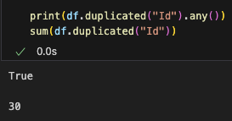
Cleaning with pandas: duplicates
We should also check for duplicates.
We have a unique identifier, Id.
duplicated allows us to check if any of the rows of the series, or even the dataframe, are duplicated, it returns a Boolean list. Post lecture edit: when it returns the Boolean list, it does not return True for the first entry of any Id. This means that there are 30 + the number of unique duplicate Ids rows in total that could be duplicates

Slide 44
Cleaning with pandas: duplicates
TOP TIP
We should also check for duplicates.
We have a unique identifier, Id.
duplicated allows us to check if any of the rows of the series, or even the dataframe, are duplicated, it returns a Boolean list.
any checks if any element in a list is True.

Slide 45
Cleaning with pandas: duplicates
We should also check for duplicates.
We have a unique identifier, Id.
duplicated allows us to check if any of the rows of the series, or even the dataframe, are duplicated, it returns a Boolean list.
any checks if any element in a list is True.
The sum of a Boolean list calculates the number of True elements.
TOP TIP

Slide 46
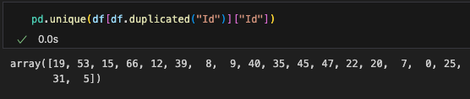
Cleaning with pandas: duplicates
This is the list of unique Ids that are duplicated.

Slide 47
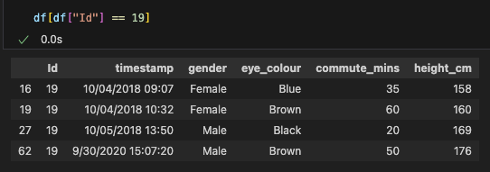
Cleaning with pandas: duplicates
This is the list of unique Ids that are duplicated.
How do we know which duplicate to keep?

Slide 48
Cleaning with pandas: drop_duplicates
This is the list of unique Ids that are duplicated.
How do we know which duplicate to keep?
The data collector says we should keep the last entry.

Slide 49
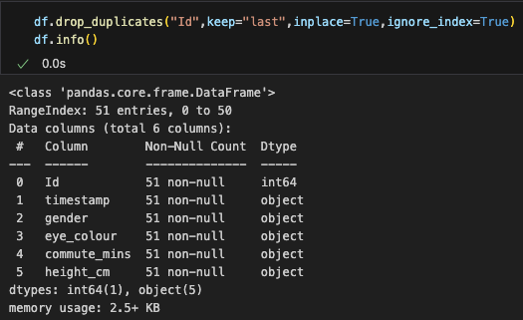
Cleaning with pandas: drop_duplicates
This is the list of unique Ids that are duplicated.
How do we know which duplicate to keep?
The data collector says we should keep the last entry.
We use drop_duplicates to remove the rows that have their Id duplicated.
ignore_index resets the index.

Slide 50
Cleaning with pandas: drop_duplicates
This is the list of unique Ids that are duplicated.
How do we know which duplicate to keep?
The data collector says we should keep the last entry.
We use drop_duplicates to remove the rows that have their Id duplicated.
Remember to write down that we have dropped another 30 out of 81 entries.

Slide 51
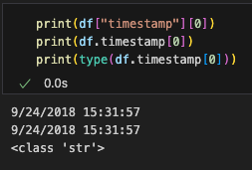
Cleaning with pandas: datetime
TOP TIP
We can access the dataframe columns using either
  df[“column_name”]
  df.column_name
  Note, df[“column name”] would work but df.column name would not. Why?

Slide 52
Cleaning with pandas: datetime
We can access the dataframe columns using either
  df[“column_name”]
  df.column_name
We know the first column should be date and time data.

Slide 53
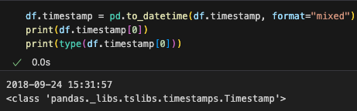
Cleaning with pandas: datetime
We can access the dataframe columns using either
  df[“column_name”]
  df.column_name
We know the first column should be date and time data.
We can use the datetime module (which is integrated into pandas) to convert it to a datetime value.

Slide 54
Cleaning with pandas: datetime
We can access the dataframe columns using either
  df[“column_name”]
  df.column_name
We know the first column should be date and time data.
We can use the datetime module (which is integrated into pandas) to convert it to a datetime value.
pandas is clever enough to tell us if there are some bad entries in a series, which is why we have format=“mixed”

Slide 55
Wrangling with pandas: extract new columns

Slide 56
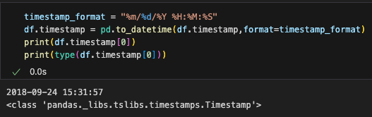
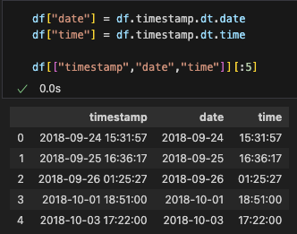
Wrangling with pandas: extract new columns
Now timestamp is in datetime, we can extract the date and time and save the into different columns.

Slide 57
Wrangling with pandas: extract new columns
Now timestamp is in datetime, we can extract the date and time and save the into different columns.

Slide 58
Wrangling with pandas: extract new columns
Now timestamp is in datetime, we can extract the date and time and save the into different columns.
Note, we need to use the “” version of accessing the dataframe to create a new column.
TOP TIP

Slide 59
Cleaning with pandas: unique
Speaking with the data collector, or having done the data collection yourself, you will be aware of the type of each answer and some typical answers.

Slide 60
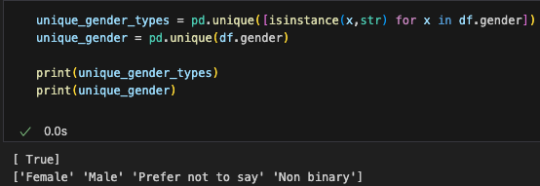
Cleaning with pandas: unique
Speaking with the data collector, or having done the data collection yourself, you will be aware of the type of each answer and some typical answers.
As we can see, all the entries in the gender are strings

Slide 61
Cleaning with pandas: unique
Speaking with the data collector, or having done the data collection yourself, you will be aware of the type of each answer and some typical answers.
As we can see, all the entries in the gender are strings and the answers all seem reasonable.

Slide 62
Cleaning with pandas: unique
Speaking with the data collector, or having done the data collection yourself, you will be aware of the type of each answer and some typical answers.
As we can see, all the entries in the gender are strings and the answers all seem reasonable.
This is called a list comprehension.
It is useful for quickly creating a list rather than doing a for loop.
TOP TIP

Slide 63

Cleaning with pandas: apply and lambda
Speaking with the data collector, or having done the data collection yourself, you will be aware of the type of each answer and some typical answers.
As we can see, all the entries in the gender are strings and the answers all seem reasonable.
Rather than creating a new list, you can use apply and lambda.
apply takes a series and applies a method to each entry.

Slide 64
Cleaning with pandas: apply and lambda
Speaking with the data collector, or having done the data collection yourself, you will be aware of the type of each answer and some typical answers.
As we can see, all the entries in the gender are strings and the answers all seem reasonable.
Rather than creating a new list, you can use apply and lambda.
apply takes a series and applies a method to each entry.
lambda is an anonymous function, here it takes a value x and checks if it is an instance of a str. Using lambda is shorthand for writing a function

Slide 65
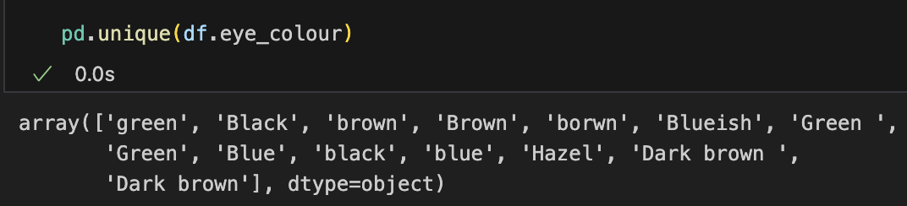
Cleaning with pandas: unique
We can see that the entries for eye_colour are messy.

Slide 66
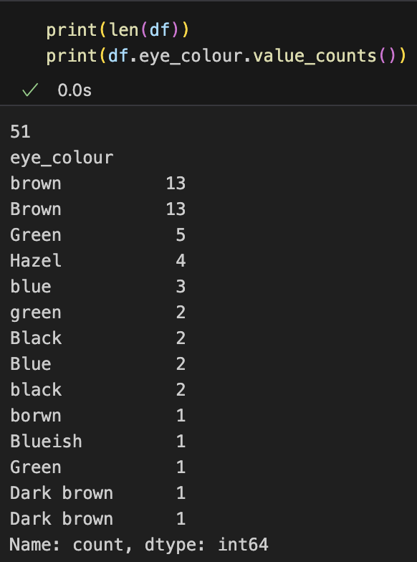
Cleaning with pandas: value_counts
We can see that the entries for eye_colour are messy.
We can use value_counts to get the unique entries and their counts.

Slide 67
Cleaning with pandas: value_counts
TOP TIP
We can see that the entries for eye_colour are messy.
We can use value_counts to get the unique entries and their counts.
Remember, we need to write down what we are edited, for example that we have edited 13 out of 51 entries from brown to Brown.
len provides a quick way to calculate the number of rows.

Slide 68
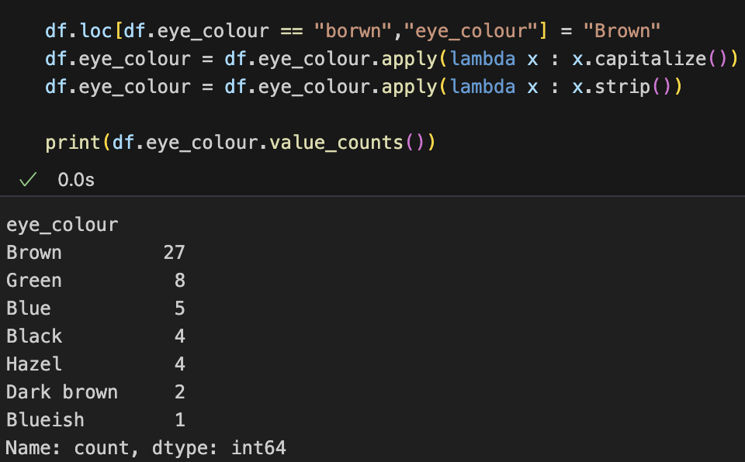
Cleaning with pandas: apply and filtering
Judging by the unique values, we will need to
  Change spelling of borwn.

Slide 69
Cleaning with pandas: apply and filtering
Judging by the unique values, we will need to
  Change spelling of borwn.
  Capitalise the first letter.

Slide 70
Cleaning with pandas: apply and filtering
Judging by the unique values, we will need to
  Change spelling of borwn.
  Capitalise the first letter.
  Strip whitespace.

Slide 71
Cleaning with pandas: apply and filtering
Judging by the unique values, we will need to
  Change spelling of borwn.
  Capitalise the first letter.
  Strip whitespace.
loc is the pandas method for us to extract and change local entries given row information
TOP TIP

Slide 72
Cleaning with pandas: apply and filtering
Judging by the unique values, we will need to
  Change spelling of borwn
  Capitalise the first letter
  Strip whitespace
loc is the pandas method for us to extract and change local entries given row information and column information.
TOP TIP

Slide 73
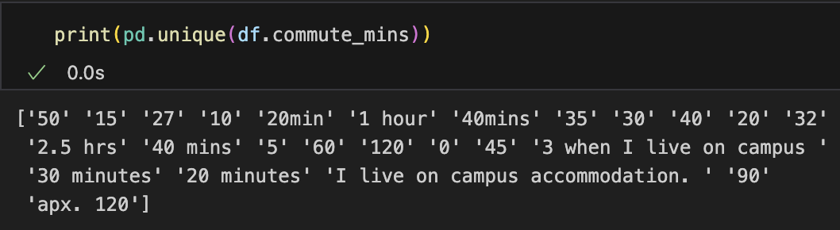
Cleaning with pandas: custom functions
What about commute_mins?

Slide 74
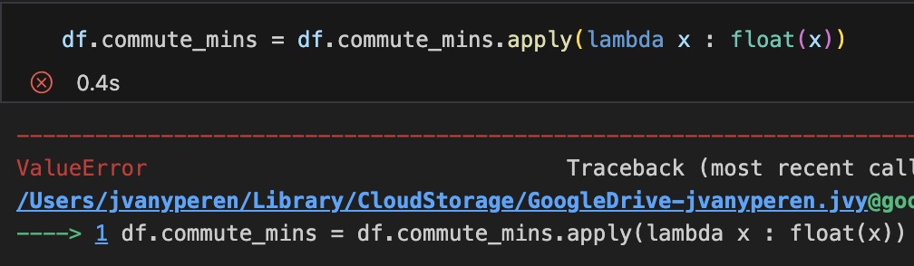
Cleaning with pandas: custom functions
What about commute_mins?
We need to convert the series to floats, however this will be trouble!

Slide 75
Cleaning with pandas: custom functions
What about commute_mins?
We can see that we will need to
  Remove “min” and “minute” from entries.
  Remove “hrs” and “hour” from entries.
  Remove “apx.” from entries.
  Post lecture addition: convert from hours to minutes.

Slide 76
Cleaning with pandas: custom functions
What about commute_mins?
We can see that we will need to
  Remove “min” and “minute” from entries.
  Remove “hrs” and “hour” from entries.
  Remove “apx.” from entries.
  Post lecture addition: convert from hours to minutes.
We cannot, and should not, assume what the data collector would want instead of the entries that contain “campus”!

Slide 77
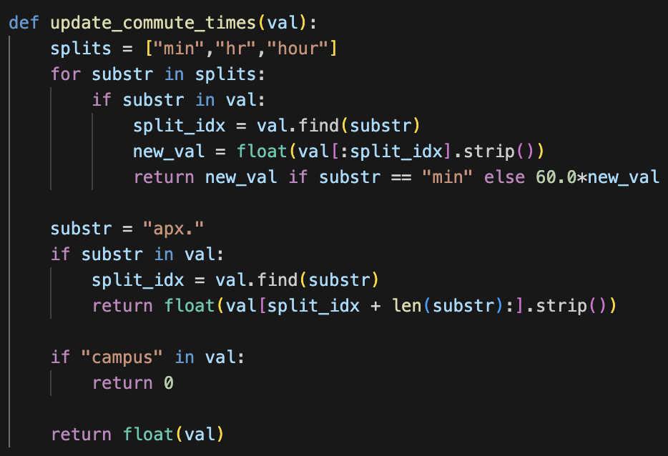
Cleaning with pandas: custom functions
What about commute_mins?
We can see that we will need to
  Remove “min” and “minute” from entries.
  Remove “hrs” and “hour” from entries.

Slide 78
Cleaning with pandas: custom functions
What about commute_mins?
We can see that we will need to
  Remove “min” and “minute” from entries.
  Remove “hrs” and “hour” from entries.
This is called an inline if statement.
TOP TIP

Slide 79
Cleaning with pandas: custom functions
What about commute_mins?
We can see that we will need to
  Remove “min” and “minute” from entries.
  Remove “hrs” and “hour” from entries.
  Remove “apx.” from entries.

Slide 80
Cleaning with pandas: custom functions
What about commute_mins?
We can see that we will need to
  Remove “min” and “minute” from entries.
  Remove “hrs” and “hour” from entries.
  Remove “apx.” from entries.
  Post lecture addition: convert from hours to minutes.

Slide 81
Cleaning with pandas: custom functions
What about commute_mins?
We can see that we will need to
  Remove “min” and “minute” from entries.
  Remove “hrs” and “hour” from entries.
  Remove “apx.” from entries.
  Post lecture addition: convert from hours to minutes.
  Change any entry involving “campus” to 0.

Slide 82
Cleaning with pandas: custom functions
What about commute_mins?
We can see that we will need to
  Remove “min” and “minute” from entries.
  Remove “hrs” and “hour” from entries.
  Remove “apx.” from entries.
  Post lecture addition: convert from hours to minutes.
  Change any entry involving “campus” to 0.
  Convert all the entries to floats.

Slide 83
Cleaning with pandas: custom functions
What about commute_mins?
We can see that we will need to
  Remove “min” and “minute” from entries.
  Remove “hrs” and “hour” from entries.
  Remove “apx.” from entries.
  Post lecture addition: convert from hours to minutes.
  Change any entry involving “campus” to 0.
  Convert all the entries to floats.
You can return in a function whenever you have reached a final state.
TOP TIP
TOP TIP
TOP TIP

Slide 84
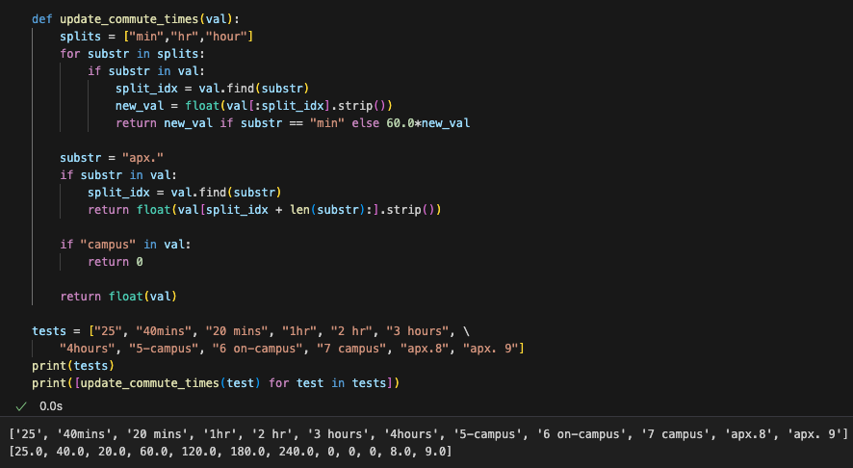
Cleaning with pandas: custom functions
This checks if a substring is contained in the other string.
TOP TIP

Slide 85
Cleaning with pandas: custom functions
This checks if a substring is contained in the other string.
This finds the index where the substring starts.

Slide 86
Cleaning with pandas: custom functions
This checks if a substring is contained in the other string.
This finds the index where the substring starts.
The \ operator allows you to span a list over several lines.
TOP TIP

Slide 87
Cleaning with pandas: custom functions
This checks if a substring is contained in the other string.
This finds the index where the substring starts.
The \ operator allows you to span a list over several lines.
It is good practice to test functions to make sure they act as you expect.
TOP TIP

Slide 88
Cleaning with pandas: custom functions
What about commute_mins?

Slide 89
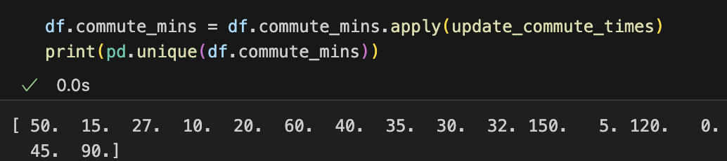
Cleaning with pandas: custom functions
What about commute_mins?
We can now apply our function to the series.

Slide 90
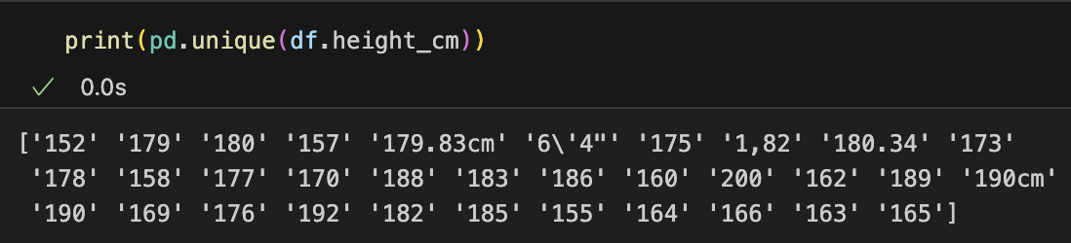
Cleaning with pandas: custom functions
What about height_cm?

Slide 91
Cleaning with pandas: custom functions
What about height_cm?
We have a similar set of issues:
  Change “,” into “.”
  Convert from metres to cms.
  Remove “cm” from entry.
  Change from imperial notation to metric.
  Convert all the entries to floats.

Slide 92
Cleaning with pandas: custom functions
What about height_cm?
We have a similar set of issues:
  Change “,” into “.”
  Convert from metres to cms.
  Remove “cm” from entry.
  Change from imperial notation to metric.
  Convert all the entries to floats.
We need to write a new function, but how might we adapt the function update_commute_times?

Slide 93
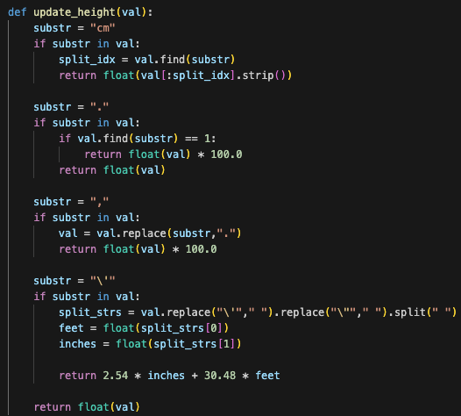
Cleaning with pandas: custom functions
What about height_cm?
We have a similar set of issues:
  Change “,” into “.”
  Convert from metres to cms.
  Remove “cm” from entry.
  Change from imperial notation to metric.
  Convert all the entries to floats.
replace and split do exactly as intended, but they overwrite the variable val without need for assignment.
TOP TIP

Slide 94
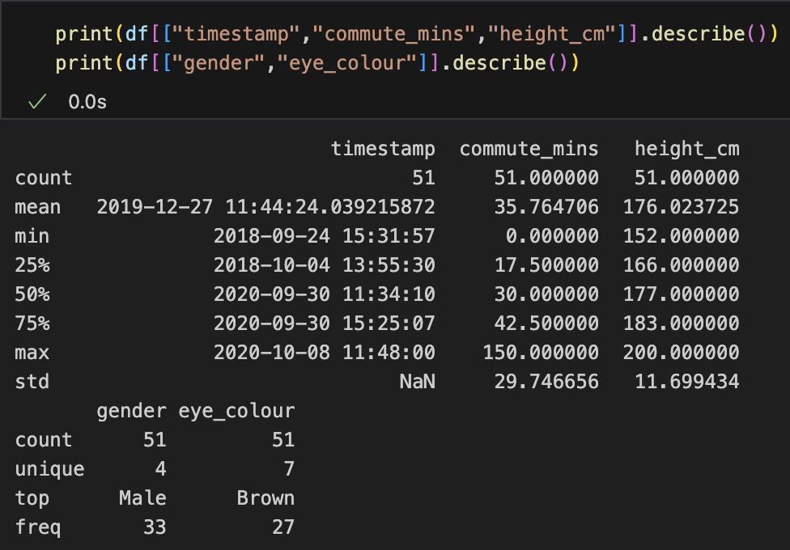
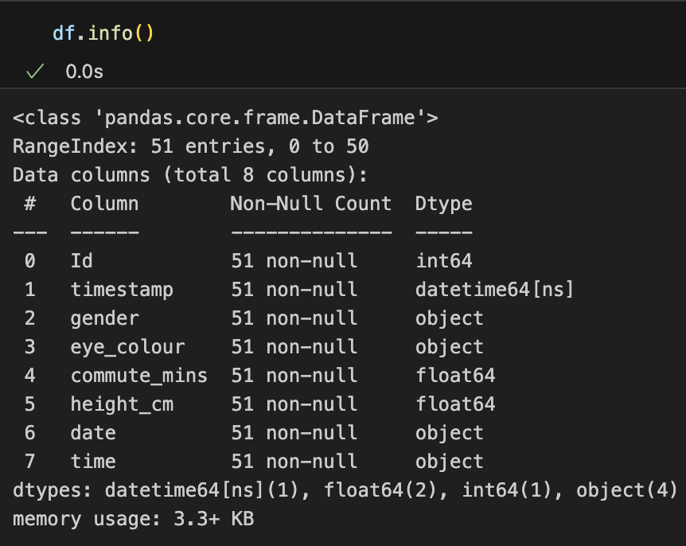
Reading data into pandas: info and describe
We can see that describe now gives us some statistical properties of certain series in the dataframe!

Slide 95
Reading data into pandas: info and describe
We can see that describe now gives us some statistical properties of certain series in the dataframe!
Notice the dtypes.

Slide 96
Wrangling with pandas: concat
We have been told by the data collector that they have found the individuals with NaN entries.
We have a new csv file with their entries that we can add.

Slide 97
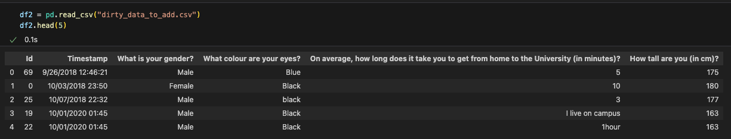
Wrangling with pandas: concat
We have been told by the data collector that they have found the individuals with NaN entries.
We have a new csv file with their entries that we can add.
Make sure dirty_data_to_add.csv is in your folder.
We will concatenate the two dataframes.

Slide 98
Wrangling with pandas: concat
We have been told by the data collector that they have found the individuals with NaN entries.
We have a new csv file with their entries that we can add.
Make sure dirty_data_to_add.csv is in your folder.
We will concatenate the two dataframes.
In order to do this we need to make sure we have the same columns.

Slide 99
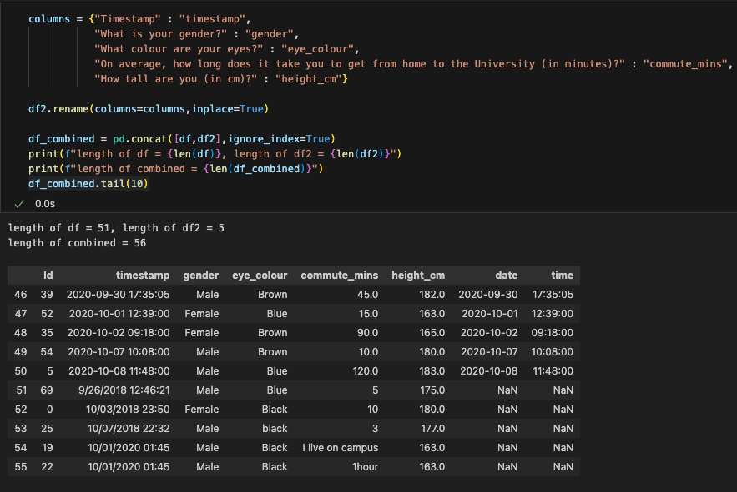
Wrangling with pandas: concat
We use concat to combine the two dataframes.

Slide 100
Wrangling with pandas: concat
We use concat to combine the two dataframes.
Notice that the columns date and time are NaN – why?
We can confirm the concat has worked as the lengths add up

Slide 101
Wrangling with pandas: concat
We use concat to combine the two dataframes.
Notice that the columns date and time are NaN – why?
We can confirm the concat has worked as the lengths add up and we see the 5 entries from dirty_data_to_add.csv at the bottom

Slide 102
Wrangling with pandas: concat
We use concat to combine the two dataframes.
Notice that the columns date and time are NaN – why?
We can confirm the concat has worked as the lengths add up and we see the 5 entries from dirty_data_to_add.csv at the bottom

Slide 103
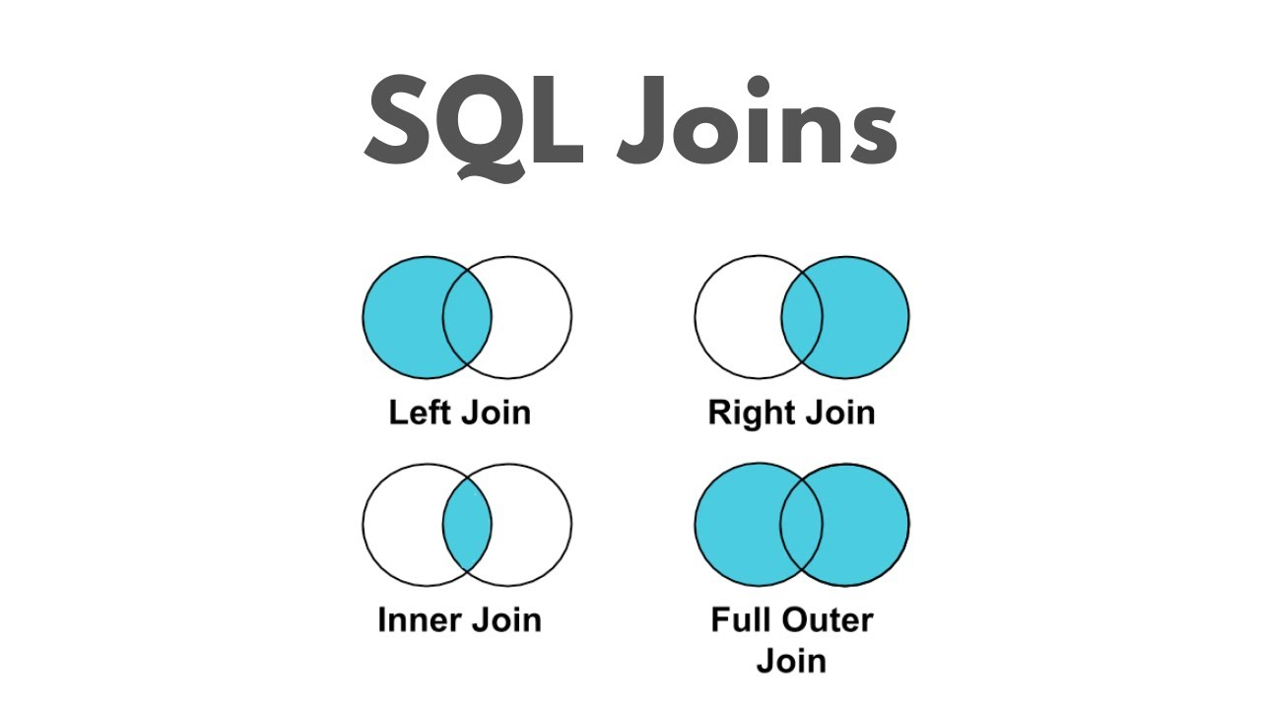
Wrangling with pandas: concat, join
What we just did was called an outer join, it is synonymous with the union – we keep all the available columns and fill in the missing values with NaN.
https://www.youtube.com/watch?v=4JLkHtIxXlA

Slide 104
Wrangling with pandas: concat, join
What we just did was called an outer join, it is synonymous with the union – we keep all the available columns and fill in the missing values with NaN.
Alternatively, we can do an inner join, which is synonymous with the intersection – we only keep what they both have it common.
https://www.youtube.com/watch?v=4JLkHtIxXlA

Slide 105
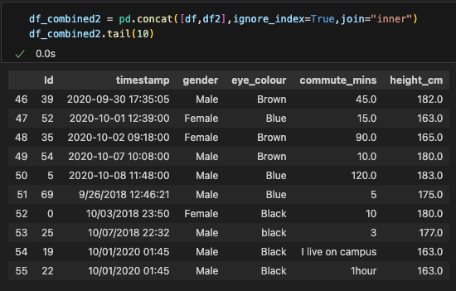
Wrangling with pandas: concat, join
What we just did was called an outer join, it is synonymous with the union – we keep all the available columns and fill in the missing values with NaN.
Alternatively, we can do an inner join, which is synonymous with the intersection – we only keep what they both have it common.

Slide 106
Wrangling with pandas: merge
We’ve been presented with a dataset that was answered by the same individuals, and we want to merge them together.

Slide 107
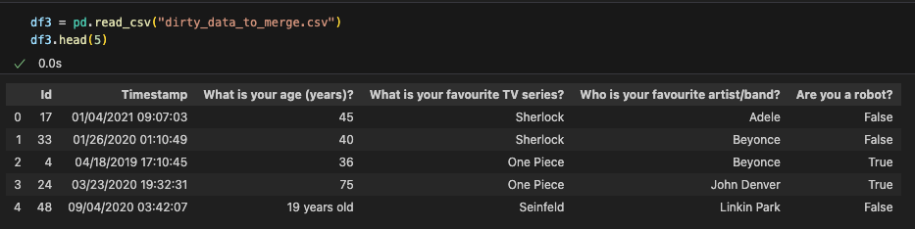
Wrangling with pandas: merge
We’ve been presented with a dataset that was answered by the same individuals, and we want to merge them together.
Make sure dirty_data_to_merge.csv is in your folder.

Slide 108
Wrangling with pandas: merge
We’ve been presented with a dataset that was answered by the same individuals, and we want to merge them together.
Make sure dirty_data_to_merge.csv is in your folder.
merging is the process of combining datasets “horizonatally” rather than “vertically” (like concat), which means we need a unique identifier (Id) to use to stitch the dataframes together.

Slide 109
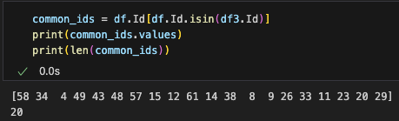
Wrangling with pandas: isin
Let us see what Ids the two dataframes share.

Slide 110
Wrangling with pandas: isin
Let us see what Ids the two dataframes share.
isin checks whether elements in the series df3.Id are in the series df.Id
It returns a Boolean list.

Slide 111
Wrangling with pandas: isin
Let us see what Ids the two dataframes share.
isin checks whether elements in the series df3.Id are in the series df.Id
It returns a Boolean list.
So we have at least 20 (dependent on duplicates) overlapping Ids.

Slide 112
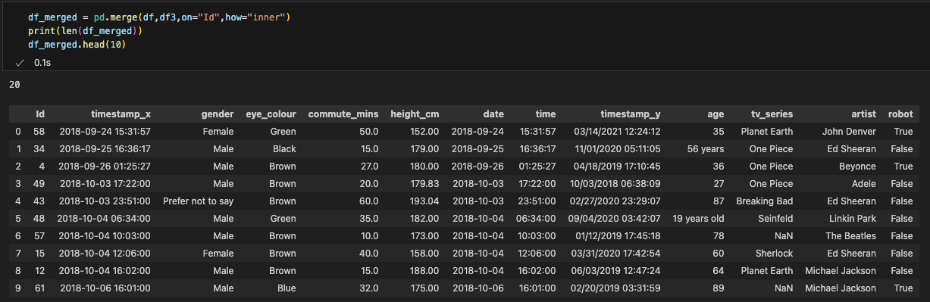
Wrangling with pandas: merge
We merge df3

Slide 113
Wrangling with pandas: merge
We merge df3 with df

Slide 114
Wrangling with pandas: merge
We merge df3 with df connecting on Id

Slide 115
Wrangling with pandas: merge
We merge df3 with df connecting on Id using the inner join method.

Slide 116
Wrangling with pandas: merge
We merge df3 with df connecting on Id using the inner join method.
We see that timestamp has been kept, but now has .x and .y to depict which dataframe it came from.

Slide 117
Wrangling with pandas: merge
We merge df3 with df connecting on Id using the inner join method.
We see that timestamp has been kept, but now has .x and .y to depict which dataframe it came from.

Slide 118
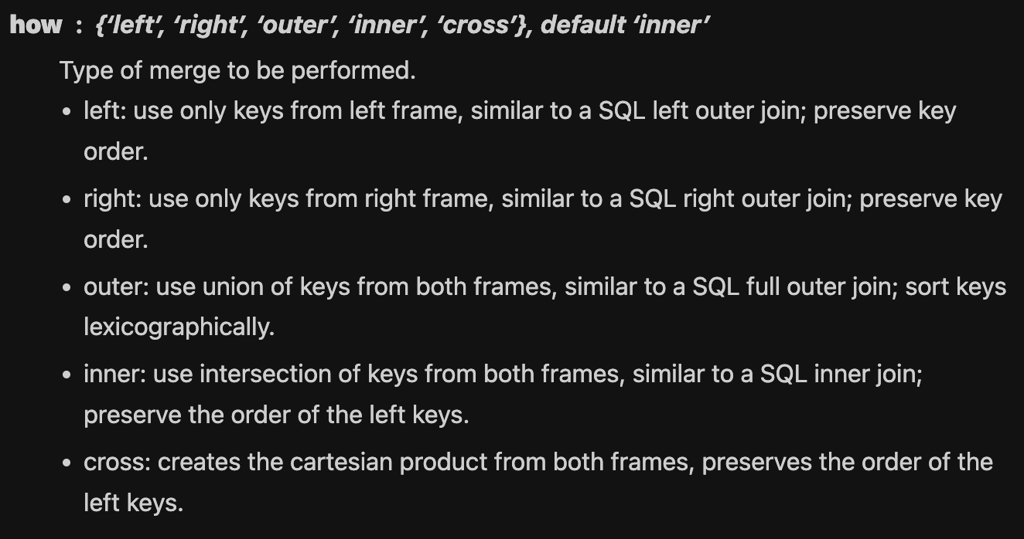
Wrangling with pandas: merge
As with concat, there are many different join methods.
https://pandas.pydata.org/pandas-docs/stable/reference/api/pandas.merge.html#pandas.merge
https://www.youtube.com/watch?v=4JLkHtIxXlA

Slide 119

pandas: where to find definitions
pandas website: https://pandas.pydata.org/docs/reference/index.html
  Here you can search for any of the functions, dtypes, attributes that we have used here.
Stack Overflow: https://stackoverflow.com/
  the largest, most trusted online community for developers to learn, share​ ​their programming ​knowledge, and build their careers.

Slide 120

The data science process: Book Recommendations
Real world
Data Solution / Product
Data Collection
Communication and Visualisation
Data Wrangling
Exploratory Data Analysis
Mathematical Modelling
Data Cleaning

Slide 121
QED
In summary, we have talked about:
  pandas;
  Lots of python top tips;
  Reading: info, describe;
  Wrangling: column names, new columns, concat, merge, join;
  Cleaning: NaN, duplicate, unique, apply.
What key points will you take home from today?
Next week: exploratory data analysis!
LABS ARE RIGHT NOW, CHICHESTER LET’S GO!

